Slide 2
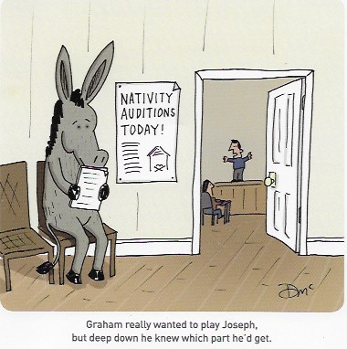

Slide 3
Jer 22:30
“None of his offspring shall succeed in sitting on the throne of David and ruling again in Judah.”
Luke 1:32
He will be great and will be called the Son of the Most High. And the Lord God will give to him the throne of his father David.

Slide 4
Luke 1.
In the time of Herod king of Judea there was a priest named Zechariah, who belonged to the priestly division of Abijah; his wife Elizabeth was also a descendant of Aaron.
Once when Zechariah’s division was on duty and he was serving as priest before God ---- Then an angel of the Lord appeared to him --- Your wife Elizabeth will bear you a son, and you are to call him John.
When his time of service was completed, he returned home. After this his wife Elizabeth became pregnant and for five months remained in seclusion.

Slide 5
Luke 1:26ff
And in the sixth month the angel Gabriel was sent from God unto a city of Galilee, named Nazareth,
To a virgin espoused to a man whose name was Joseph, of the house of David; and the virgin's name was Mary. ---- And, behold, thou shalt conceive in thy womb, and bring forth a son, and shalt call his name JESUS. --- And Mary arose in those days, and went into the hill country with haste, into a city of Judah and entered into the house of Zechariah. And Mary abode with her about three months, and returned to her own house.

Slide 6
Luke 3
Now in the fifteenth year of the reign of Tiberius Caesar, -----
the word of God came unto John the son of Zacharias in the wilderness. And he came into all the country about Jordan, preaching the baptism of repentance for the remission of sins.

Slide 7
Luke 2
In those days Caesar Augustus issued a decree that a census should be taken of the entire Roman world. (This was the first census that took place while Quirinius was governor of Syria.) And everyone went to their own town to register.
Matt 2:1
Now after Jesus was born in Bethlehem of Judea in the days of Herod the king,

Slide 8
Gen1:14
And God said, “Let there be lights in the expanse of the heavens to separate the day from the night. And let them be for signs and for seasons, and for days and years,

Slide 10
Rev 12
And a great sign appeared in heaven: a woman clothed with the sun, with the moon under her feet, and on her head a crown of twelve stars. She was pregnant and was crying out in birth pains and the agony of giving birth --- She gave birth to a male child, one who is to rule all the nations with a rod of iron.

Slide 11
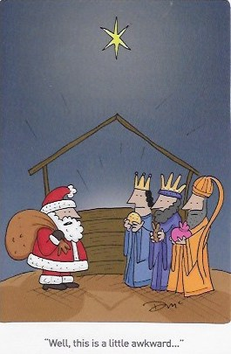

Slide 12
Matt 2:2
“Where is the one who has been born king of the Jews? We saw his star when it rose (or in the east)

Slide 14
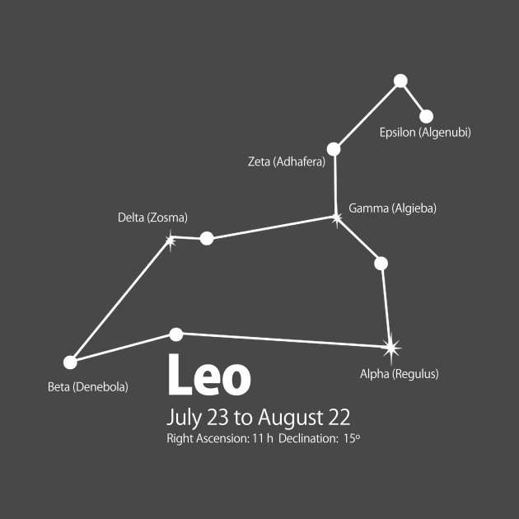

Slide 15
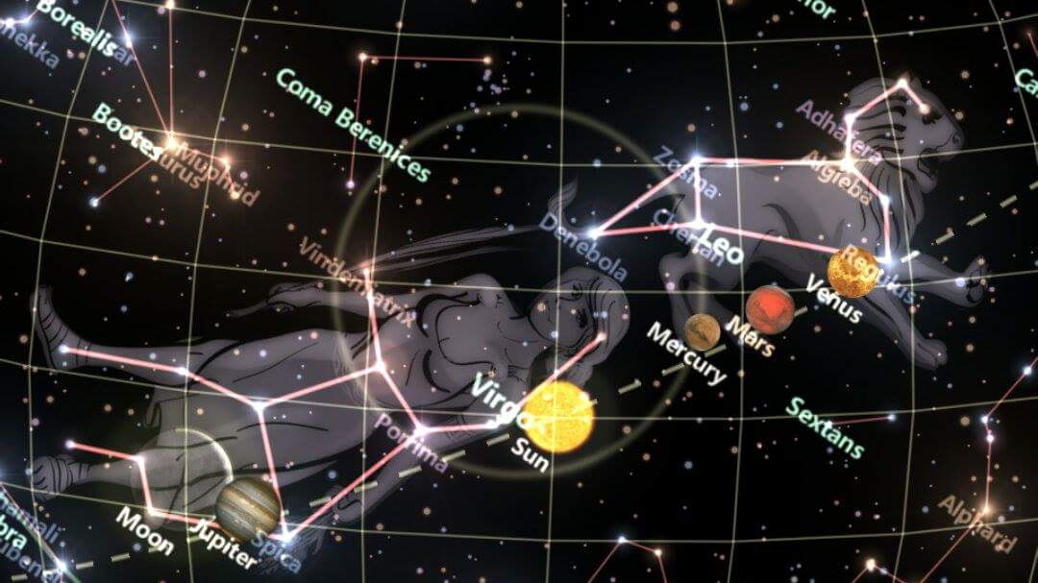

Slide 16
Mat 2:9
After they had heard the king, they went on their way, and the star they had seen when it rose went ahead of them until it stopped over the place where the child was.

Slide 17
Mat 2:3
When Herod the king had heard these things, he was troubled, and all Jerusalem with him.

Slide 18
Luke 2:4-7
And Joseph also went up from Galilee, from the town of Nazareth, to Judea, to the city of David, which is called Bethlehem, because he was of the house and lineage of David, to be registered with Mary, his betrothed, who was with child.
And while they were there, the time came for her to give birth. And she gave birth to her firstborn son and wrapped him in swaddling cloths and laid him in a manger, because there was no place for them in the inn.

Slide 19
Luke 2:8.
And there were in the same region shepherds abiding in the field, keeping watch over their flock by night.

Slide 23
Micah 4:8
And you, O tower of the flock, hill of the daughter of Zion, to you shall it come, the former dominion shall come, kingship for the daughter of Jerusalem.

Slide 24
Luke 2:11-12
A Saviour is born to you today, who is Messiah the Lord. And the sign to you is this: you will find an infant wrapped in swaddling cloths and lying in a manger

