Slide 1
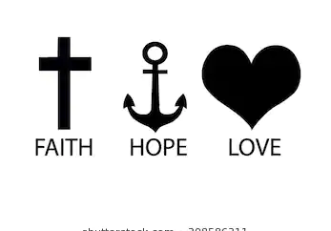
Faith, Love and hope

Slide 2
I hope I get............goal.....
I hope my …............vision.
I hope this condition will clear ….........dream
Greatest hope Luke 3 .15 people were filled with expectation
Colossians 2.14 erasing the record that stood against us , nailing to the cross .That is the finished work of Jesus .
Acts 3.5 expecting to receive and healing came to the crippled begger .look at us .Man expected and healing was activated

Slide 3
Hope Is Already in You
At that time you were without Christ, being aliens from the commonwealth of Israel and strangers from the covenants of promise, having no hope and without God in the world–Ephesians 2:12, NKJV
Hopelessness is not caused by a lack of education, a lack of money or a lack of opportunity. Hopelessness comes from being without hope and without God in the world. So, if you have God, you have hope. But, like anything else, you have to feed your hope with the Word of God.

Slide 4
Hope Is Always at Work
“But if we HOPE for what we do not yet have, we wait for it patiently.” –Romans 8:25, NIV
The powerful force of hope is a supernatural expectancy. But, keep in mind, you can expect something good or bad. Either way, you’re operating in the powerful force of hope. When you expect something good, you’re operating in hope that comes from the truth of God’s Word. When you are expecting something bad or negative, you’re operating in natural hope or even evil hope.

Slide 5
The Five P’s of Life – Patience, Persistence, Perseverance, Passion, and Purpose

Slide 6
when you hear about negativity, you’ll likely think about negative things, bad ideas, grumpy cat, scowling coworkers and a generally unpleasant experience. Despite the concept of positivity being ideal, for many people, it is a hell of a lot easier to be negative than positive, making it a very contagious demeanor.

Slide 7
Bible Hope is the hope that does not disappoint or play you out .This is immovable , unshakable and utterly trustworthy
Rom 5.5 Hope does not disappoint , because the love of God has been poured out in our hearts by the holy spirit who was given to us by the holy spirit
God wants you to enjoy the steadfast hope that carries you through amazing breakthroughs and victories

Slide 8
Romans foundational principle is the Love of God which is linked to the Holy spirit .
I believe and I will ....................
There is power in Love when Holy spirit connects
Romans 4:20-21 King James Version (KJV)
20 He staggered not at the promise of God through unbelief; but was strong in faith, giving glory to God;
21 And being fully persuaded that, what he had promised, he was able also to perform.

Slide 9
Hope Always Sees
“…the evidence of things not seen.” –Hebrews 11:1, KJV
The unseen things mentioned in hebrews 11The unseen things mentioned in Hebrews 11:1 are things seen with the eyes of hope. Hope always sees before the natural eye can. Some people have trouble focusing on those unseen things. They’re hung up on what their natural eyes see instead. After all, they reason, that’s reality.
How can you see through the eyes of hope? By renewing your mind—read, study and meditate on the Word of God. Pray and listen to the Holy Spirit. That is how we get ourselves out of the natural realm

Slide 10
Hope Is the Blueprint of Faith
“Faith is the substance of things Hoped for….” –Hebrews 11:1, KJV
Just as the Bible is the blueprint for Christian living, hope is the blueprint of faith. Faith has to have hope to work. Hope has to have faith to produce.
Hope gives you the picture of what God wants for you through the Word of God. Then, faith takes that idea and goes after it. That is how hope and faith work together. Hope is the plan that faith sets out to accomplish. It’s the goal setter.

Slide 11
Hebrews 11.1 faith is the substance of things hope for , the evidence of things not seen ,if you Can you think of a single thing to do with a rubber band in its “relaxed,” natural state? Yet when you stretch out t. Put a couple of rubber bands in front of a kid and in minutes you’ll have a car, a gun, a bouncy ball, chopsticks … but they all require stretching. Like a rubber band, your faith is useless unless it’s stretched.

Slide 12
Too many believers are living in their minimum rather than reaching their maximum! When that rubber band is stretched, it’s not getting any bigger than it already was … it’s just expanding to its maximum potential. Remember we serve a God who all throughout the Bible asked people to do the impossible. . But when you stretch yourself out there and reach for the impossible, that’s when God steps in and makes it possible!

Slide 13
Mark 5.26 no better , suffered many things , grew worse
Behind him , touched his garment –Fountain of her blood dried up –healed of affliction
Expectation –ignited her faith and made her whole
Hope will not disappoint because it is anchored to lords love and finished work

Slide 14
When you are being stretched, you feel like you could snap at any moment.
Miracles come at the stretching points. We want it easy, but miracles happen when we reach the end of ourselves. Many of the Bible’s greatest miracles came when people reached the end of what they could do in the natural and had to depend on the Lord to work through them.

Slide 15
Whatever He says to you…do it. No matter how much it stretches you, do what the Lord tells you to do.
You don’t need an addition; you need an extension. Don’t look for God to send you more than you have.

Slide 16
What do all athletes do before a big game or even practice? Stretching is necessary. It’s not what hurts you; it’s what keeps you flexible. Stretching is the ability to get longer and wider without breaking or tearing. So embrace the stretch. It’s not going to break you—it’s going to make you!

Slide 17
Isiah 40.31 But they who wait for the LORD shall renew their strength; they shall mount up with wings like eagles; they shall run and not be weary; they shall walk and not faint.
Regardless of who you are or what condition your life is in, you can’t function successfully without hope in God. If circumstances are bad, you surely need hope. And if they are good, you need hope that they will stay that way!

Slide 18
Impossible situation? Don’t stop believing!
Never assume that where you’ve been or where you are is as good as it gets. And when your goal or your situation seems impossible, keep in mind that nothing is impossible for God.
Mathew 19.26, Jesus said, “With man this is impossible, but with God all things are possible.”
It doesn’t matter what the situation looks like around you; God is greater than any obstacle you may be facing. Everything that has never been done is impossible until someone does it, so why can’t it be you?
Don’t allow your mind to become a hindrance to the things you can accomplish in life. Think big—the way God does!

Slide 19
So throw your hopes, visions, and God-given dreams out there. This will give your faith something to go after. We don't have to be consumed by our problems. It leads us only to frustration. Instead, we can choose to be consumed by hope. Then we'll be in faith, and through faith we'll see God's promises become a reality in our lives.

Slide 20
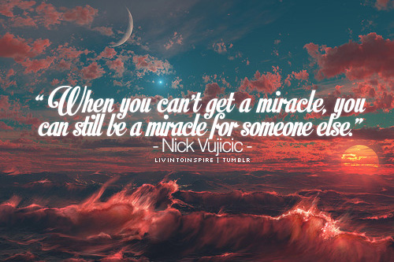

Slide 21
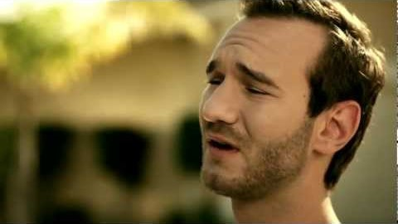
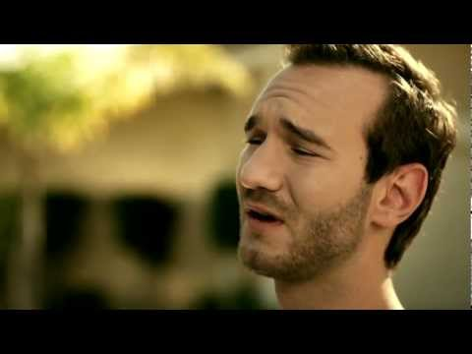

Slide 22
Let Hope will start motivating you and driving you toward God the Father.
Thank you Jesus

